Slide 1
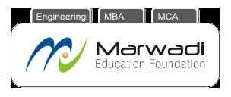
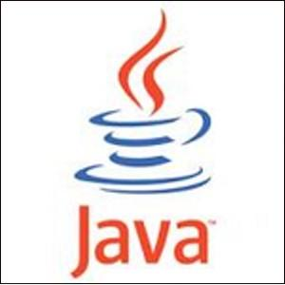
Marwadi Education Foundation’s Group of Institutions Faculty of Computer Applications MCA Sem- III
Fundamental of Java Programming
(630002)
Unit – 1
Introduction to Java

Slide 2
Introduction to Java
Java is a general purpose object oriented Programming language. It is developed by Sun Microsystems of USA in 1991.
Its original name was Oak given by James Gosling, who is one of the inventors of the language.
Java was initially Developed for Softwares for Consumer Electronics Devices like TVs, VCRs, and others.

Slide 3
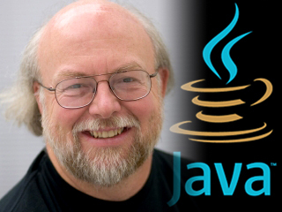
The father of Java – James Gosling

Slide 4
Introduction to Java
Java has taken the most popular languages of that time i.e. C and C++ as base by considering its various features and removing their limitations.
With this they have develop a most simple, reliable, portable and powerful language.

Slide 5
History of Java
Year | Development
1990 | Sun Microsystems decided to develop a special software for consumer electronics devices. A Team has been formed to undertake this task. James Gosling was the head of that team.
1991 | The team announce a new language called “Oak”
1992 | The team known as “Green Project” team, have demonstrated the use of language on a list of home appliances.
1993 | World Wide Web (WWW) has given support to Green Project Team and they have started thinking for development of Web Applets
1994 | A new Web browser called HotJava has been developed by the Team to run applets.
1995 | Oak was rename to Java due to some legal problems.
1996 | Sun release Java Development Kit 1.0 (JDK 1.0)

Slide 6
History of Java
Year | Development
1997 | Sun release JDK 1.1
1998 | Sun release Java 2 with JDK 1.2
1999 | Sun release J2SE and J2EE
2000 | JDK 1.3
2002 | JDK 1.4
2004 | JDK 1.5
2006 | JDK 1.6

Slide 7
Features to Java
Java has various features which makes it simple, secure and compact. They are as follows:
Compiled and Interpreted
Platform Independent and Portable
Object Oriented
Secure
Distributed
Familiar, Simple and Small
Multithreaded and Interactive
High Performance
Dynamic and Extensible

Slide 8
Features to Java
(1) Compiled and Interpreted :
Usually a computer language is either compiled or interpreted. But java combines both the approaches. First java compiler translates the source code into byte code instructions. Bytecodes are not machine instructions so in second stage, Java Interpreter generates machine code and execute the code. So we can say that java is Compiler and Interpreter.

Slide 9
Phase – I (Compilation)
Java Program
Source Code
Java Compiler
Virtual Machine
Byte Code
Phase – II (Interpretation)
Virtual Machine
Byte Code
Java Interpreter
Java Interpreter

Slide 10
Features to Java
(2) Platform Independent and Portable :
Java programs can be moved easily from one system to another, anywhere and anytime. Due to this reason only the java is the most popular language on the internet. Java is Platform independent because it does not generates the machine code but it generates a code for JVM (Java Virtual Machine) so the program can be run on any machine without any problem.

Slide 11
Features to Java
(3) Object Oriented :
Java is pure Object Oriented Programming Language. Almost everything in java is an object. All programs, codes and data always resides inside the objects and classes.

Slide 12
Features to Java
(4) Secure :
Java is a secure language. It has compile time and run time checking for data types. On the other hand java provides the assurance that no viruses will be communicated with applets. One more thing is java does not support pointers so no question of memory address to user.

Slide 13
Features to Java
(5) Distributed :
Java is a language developed for distributed language for creating application on networks. It has ability to share both – data and programs. This will allow the programmers at various remote locations to work together on a single project.

Slide 14
Features to Java
(6) Simple, Small and Familiar :
Java is simple language because many of the features are from C and C++. Again it removes problems from C and C++ like (1) it does not support pointers, (2) Preprocessors (3) goto statement and many others.
Java is small language because it consist of only Six packages.
It is familiar because it looks like C++. In other words we can say “Java is simplified version of C++”.

Slide 15
Features to Java
(7) Multithreaded and Interactive :
Multithreading means handling multiple tasks simultaneously. Means that we can do more then one work at a time. E.g. listening music is one work and download from internet is another work is the example of Multithreading.
Through java we can develop programs for interactive systems like cellphones, lcds etc.

Slide 16
Features to Java
(8) High Performance :
The performance of Java is quite impressive because it uses compilation and interpretation both. It gives a very much high performance to the java programs. Java architecture has also reduce the overheads which also improves the performance.

Slide 17
Features to Java
(9) Dynamic and Extensible:
Java is dynamic language. It is capable of creating new classes, methods and objects.
Java supports functions written in C or C++ also. This is known as native code. This native code will bind with the code dynamically.
Java is Extensible because we can define our own classes also which can be added to the pure java language.

Slide 18
Comparison between C and Java
Java does not have sizeof or typedef
Java does not have struct and union
Java does not have pointers
Java does not have preprocessors like #include, #define etc.
Java has new operator instanceof
Java has various features of OOP which are not there in C

Slide 19
Comparison between C++ and Java
Java does not support Operator Overloading
Java does not have template classes
Java does not support multiple inheritance instead of that it uses interface
Java does not support global variable declaration
Java does not use destructor instead of that it uses finalize() method
There are no header files in java

Slide 20
Summary of C, C++ and Java
C++
Java
C

Slide 21
Process of Building and Running Java Application
Text Editor
Java Source Code
javac (Compiler)
Java class file
java (Interpreter)
Java Program Output

Slide 22
Thank You

